Slide 1
Ancient Rome

Slide 2
Geography
The Geography of Ancient Rome was characterized by:
* A peninsula extending about 750 miles from north to south.
* Apennine Mountains, a ridge from north to south down the middle of the peninsula.
* Fairly large fertile plains for farming.
* Most important farm land was the PO River Valley in the north,
and the plain of LATIUM, on which the city of Rome is located.
* The region of Campania, to the south of Latium, also rich land.
* First people arrived circa 1500 – 1000 B.C. An Indo-European people who spoke Latin…little known about them.
* Greeks and ETRUSCANS arrived about 800 B.C.

Slide 3
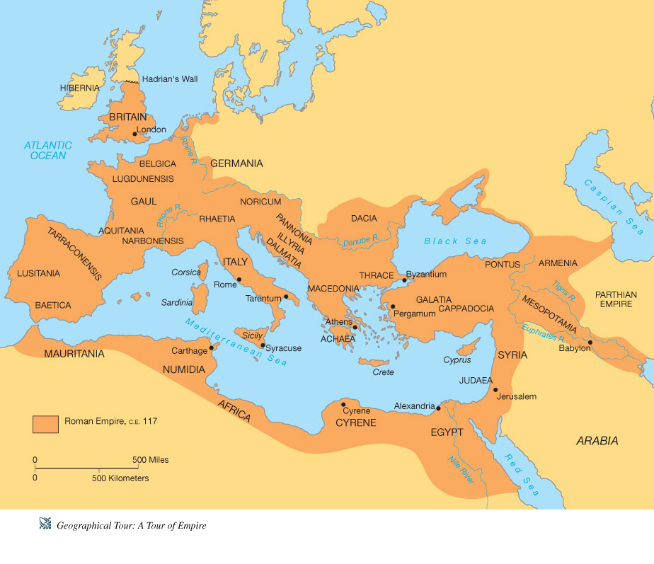

Slide 4
Rome circa 500 B.C*****.
* The Etruscans, Greeks and Latins came to the Italian Peninsula circa 1500-1000 BC.
* By 650 B.C. the Etruscans dominated the north and most of Latium.
* By 500 B.C. , the Romans had over thrown the Etruscans, and established a Republic. This was the beginning of a new era in Roman history.

Slide 5
Roman Republic
The Roman Republic was the period of the ancient Roman civilization when the government operated as a republic, a government with elected representatives.
* PATRICIANS – the ruling class.
* PLEBIANS – smaller landowners, merchants, farmers, artisans, etc.
* CONSULS – led the Roman army into battle.
* PRAETORS - in charge of civil law.
* SENATE – 300 patricians who served for life…made laws for all.
* COUNCIL OF THE PLEBS – so important for military, gained power beginning circa 470 B.C. Given their own assembly.
* TRIBUNES OF THE PLEBS – circa 300 B.C. were chosen as military leaders.

Slide 6
The Map of the Roman republic in 45 BC

Slide 7
THE PUNIC WARS 260 – 146 B.C.
* Three series of wars with Carthage, a northern African city-state.
* Punicus is Latin for “Phoenician”; Carthage interfered with Rome’s ability to freely trade in the Mediterranean.
* When Rome sent an army to Sicily, war began, with Roman navy defeating Carthaginian forces.
* Hannibal took 46,000 men, animals (37 elephants) across the Alps in 2nd invasion. Rome survived and took control of Spain.
* Third War ended with Carthage destroyed, and Rome major military power in Mediterranean.

Slide 8
The Roman Empire*******
Began with Julius Caesar’s becoming dictator for life in 45 B.C. (also known as B.C.E. – before the common era).
Members of roman Senate killed Caesar in 44 B.C.
* His heir and grandnephew, Octavian, won struggle for control of empire.

Slide 9
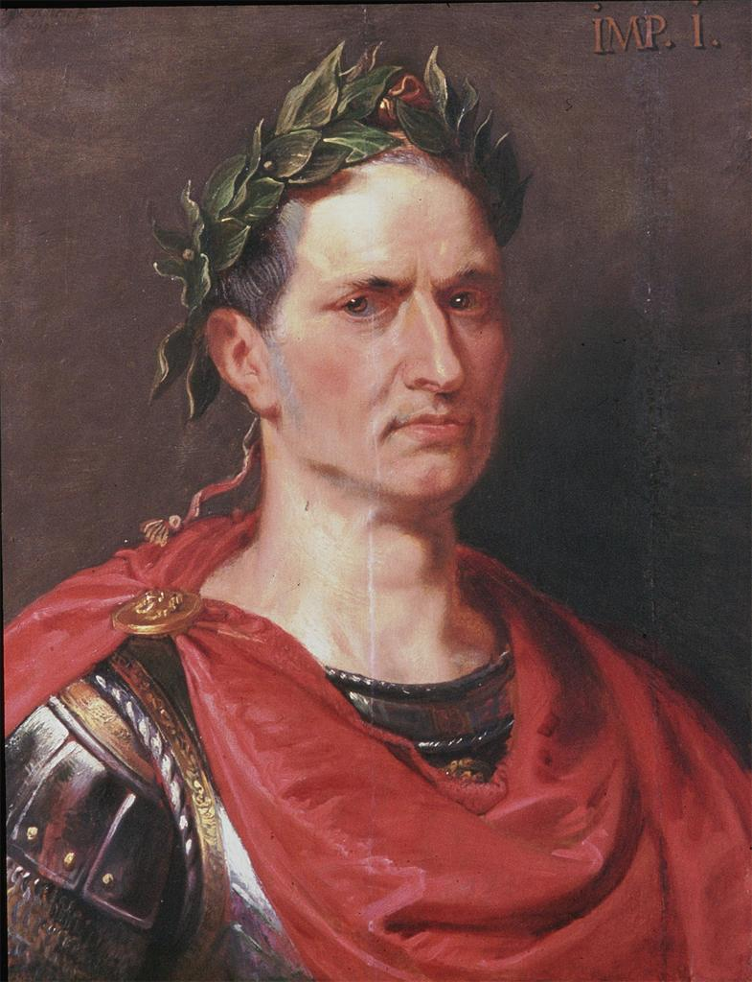
Julius Caesar
General | Politician | Dictator
Hero | Killed 44 B.C. | Martyr

Slide 10
Julius Caesar

Slide 11
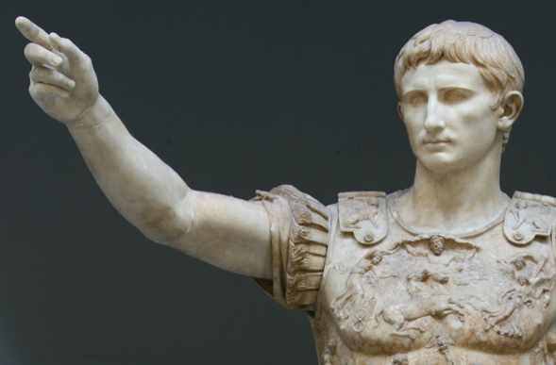
Augustus Caesar
* First emperor of
Rome, “Augustus”.
* “Revered one”.
* Formed the 2nd
Triumvirate to hunt
down Caesar’s
assassins.
* Defeated Marc
Antony & Cleopatra.

Slide 12
Map of Ancient Rome, C.E. 117 **

Slide 13
The Rise of Christianity******
Began in Rome with Peter the apostle.
Believed Jesus was the “Christos”.
“Christos” meaning Savior or Messiah .

Slide 14
EARLY Christian Disciplines**

Slide 15
The Origin of Christianity***
Began with Jesus, a Jew from Galilee.
Basis philosophy is by accepting Jesus as Christ, people can be saved from sin and reconciled with God.
*Peter went to Rome. And became the first “papi” of church.
Latin word for
universal is “catholic”.
Holy book is the Bible.
Two sections: Old Testament and new Testament.
Constantine was the 1st Christian emperor, and issued the Edict of Milan (legalized) 313 A.D.
Theodosius made it the official religion of Rome.
*Became known the Roman Catholic Church.

Slide 16
The Christian Philosophy***
Jesus traveled and preached throughout Judaea and neighboring Galilee as a Jewish Prophet. His message was what was important was not strict adherence to the law but you’re inner self. “ So in everything, do to others what you would have them do to you, for this sums up the Law and the Prophets.” God’s command was to love God and one another.
The Christian movement began within Judaism and won followers in Jerusalem, Judaea, and Galilee. Prominent apostles (leaders) arose in early Christianity such as Simon Peter, and Paul. The teachings of early Christianity were passed on orally. The New Testament formed the second part of the Christian Bible. Most early Christians came from the Jews and the Greek speaking populations, however an increasing number of followers were Latin-speaking people.
The Romans first paid little attention to the Christians, considering them another sect of Judaism. This attitude started to change. The Romans came to view Christians as harmful to the state because they refused to worship the state gods and emperors. This refusal to worship was seen as treason, and punishable by death. The Roman government began persecuting Christians during the reign of Nero A.D. 54-68.
**

Slide 17
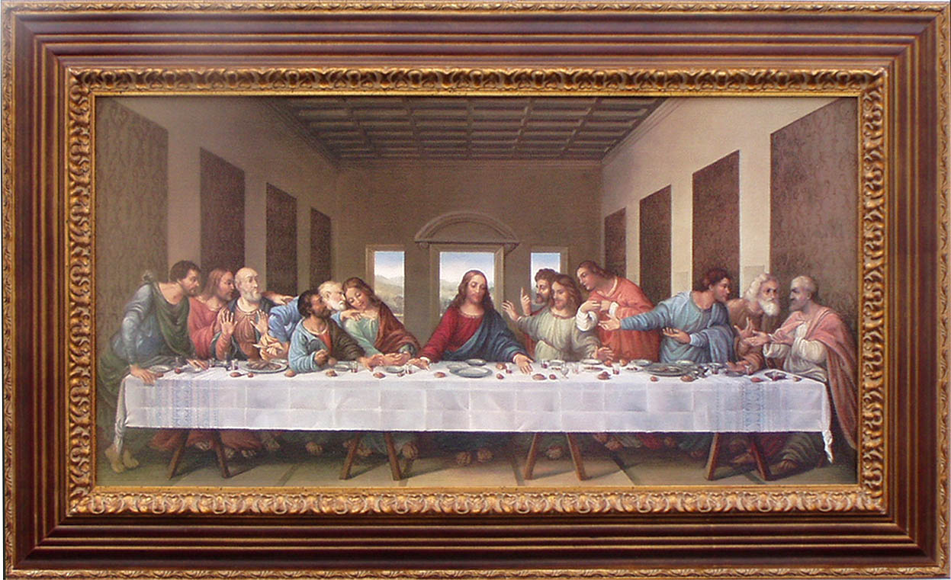
The Last Supper

Slide 18
The Organization of the Early Christian Church
Western Christendom
The Five Leading Christian Cities (Rome, Constantinople, Alexandria, Antioch, Jerusalem) | Patriarch
Province | Archbishop
Diocese | Bishop
Village | Priest

Slide 19
The Seven Sacraments****
Baptism
Penance
Holy Eucharist
(communion)
Confirmation
Matrimony
Anointing of the sick
Holy orders

Slide 20
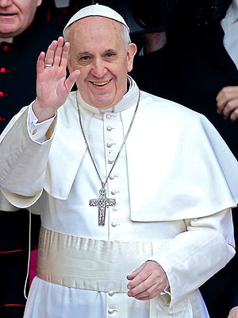
Pope Francis I
* “Papi” of all Catholics worldwide.
* Lives @ the Vatican.
* 1ST Pope from the Americas.
* AKA Bishop of Rome.
* Noted for his humility.

Slide 21
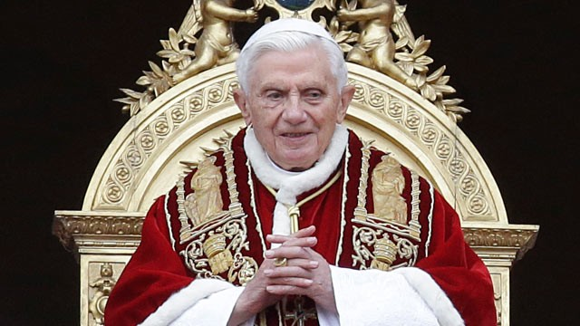
* Benedict XVI 1st German Pope.
* Elected to papacy 2005 – 2013.
* 1st time in this century two living popes, as they serve for life, and die in office.

Slide 23
The Pieta: Masterpiece by Michealangelo

Slide 24
St. Peter’s Basillica & Vatican Square

Slide 25
The Extent Of The Roman Empire
The five “good emperors” Nerva, Trajan, Hadrian, Marcus Aurelius and
Antoninus Pius created a peace of peace and prosperity, which lasted for 100 years.
Known as the Pax Romana , “the Roman
Peace”.
The empire was so large, there were two capitals, and two emperors:
Western empire – Rome
Eastern empire- Byzantium, later e-named Constantinople (today named Istanbul).

Slide 26
The Decline and fall of Rome
* By the late 5th century, Rome was too weak to fight off constant invasions (Goths, Vandals, Visigoths, the Huns).
* Reasons: invasions, civil wars, and plague came close to causing an economic collapse.
* In 476 A.D. Romulus Augusta was overthrown by the Germanic head of the military. This date ended ancient times.

Slide 27
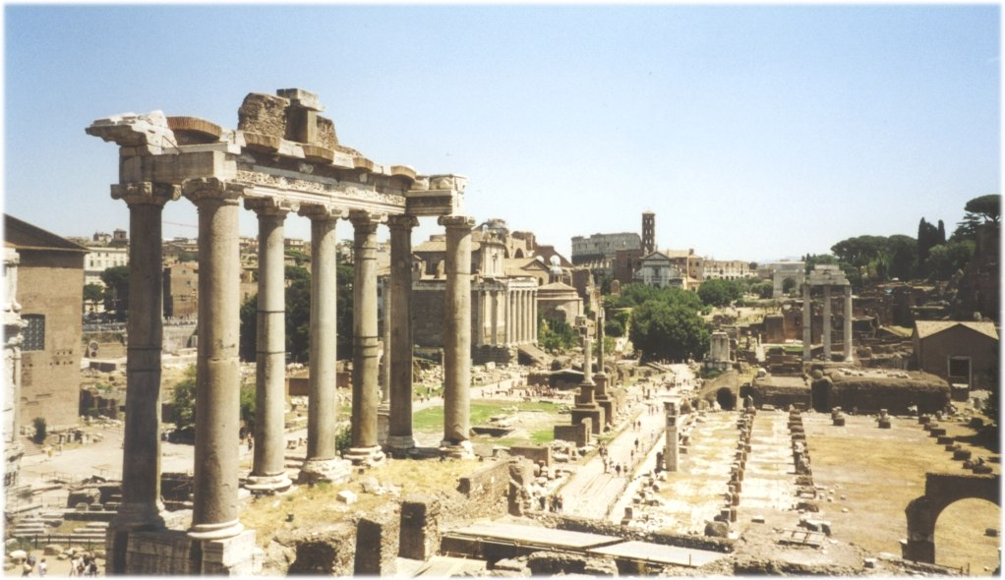
The Modern City of Roma

Slide 28
The Byzantine Empire (Eastern)*
* Even though the western Roman Empire “fell” in 476 A.D. the eastern empire continued to remain strong and powerful.
* Capital was Constantinople.
* Justinian re-captured land and codified Roman law.
* Church was the Eastern Orthodox Church headed by the Patriarch, language Greek.

Slide 29
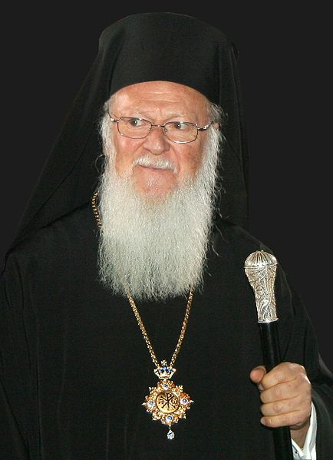
Bartholomew I*
* Head of the Eastern Orthodox Church.
* Known as the Patriarch of Constantinople.
* Resides in Turkey.

